Slide 1

Qck Weather
Creative Brief
Developed By
Chris Carlisle

Slide 2
Table of Contents
Vision .......................................... 3
The Need ...................................4
Target Platform …....................... 5
Who Will Want This? …............... 6
Competitive Analysis ..….............. 8
Feature List …............................ 10
Style Guide ….............................. 11
Wireframes ….............................. 13
Moodborads …............................14
Application Flow ….......................15
About the Developer …................16

Slide 3

Vision
To become your go-to app for quick easy to read weather information to help plan what you’ll need today, or for the next few weeks.

Slide 4
The Need
While there are a number of weather apps, there’s no SIMPLE weather app that just gives you what you need in a quick, engaging fashion. Weather can bog the user down with numbers and readings that may often be more than the user is wanting to know. These extra readings take up space on the screen, and clutter the user’s view. Many users want a simple, colorful view of the basic information that they will use to plan their day or days.

Slide 5
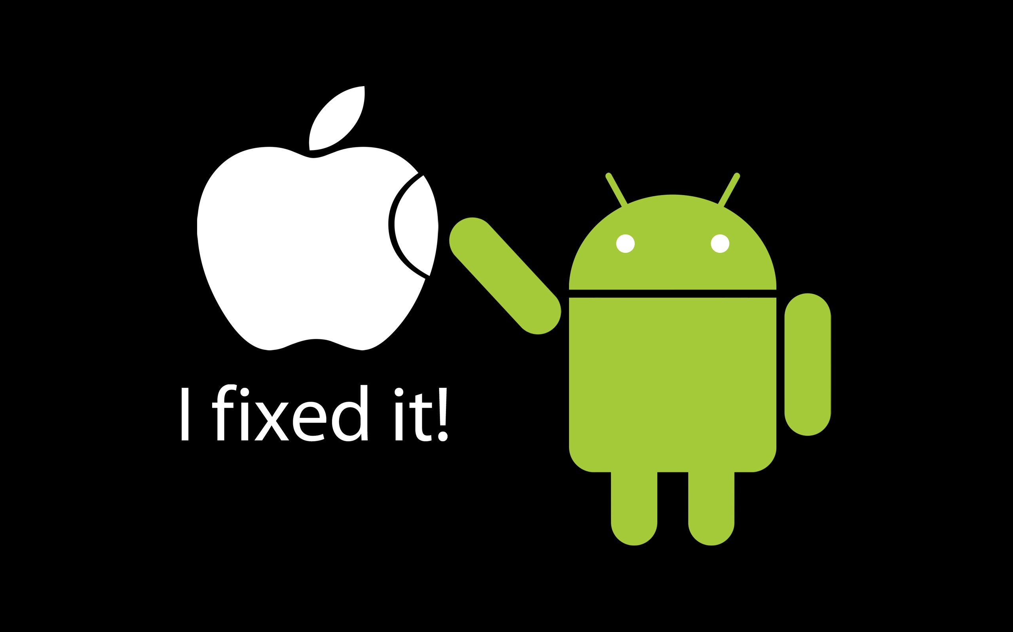
Target Platform
While there are a number of weather apps, there’s no SIMPLE weather app that just gives you what you need in a quick, engaging fashion. Weather can bog the user down with numbers and readings that may often be more than the user is wanting to know. These extra readings take up space on the screen, and clutter the user’s view. Many users want a simple, colorful view of the basic information that they will use to plan their day or days.

Slide 6
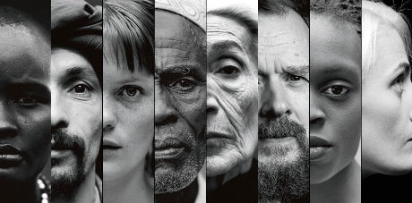
Who Will Want This?
Target Audience
QCK Weather is for anyone who wants to know what their weather will be like, but doesn’t want a bunch of other information that they don’t understand. They don’t consider themselves to be “into weather,” they just want to know how hot or cold, and wet or dry it is going to be.
Target Demographic
QCK Weather will be marketed to young males and females in the 18 to 34 age range, but can appeal to all ages and social classes. It will appeal to anyone who desires a quick answer to their weather condition and forecast questions without getting more information than they are concerned with getting.

Slide 7

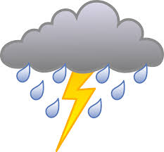
Who Will Want This?
Katherine - Age 36
Katherine is a busy, working mom. Her two young kids love to play outside. Each morning, she has to know what the weather will be like, so that she can dress the children for playtime success. Katherine doesn’t have time for dew points and outflows. All she wants to know if is she needs to send a raincoat out the door to school.
Kaylee - Age 17
Kaylee is always busy. She is constantly going somewhere with her friends, family, or church youth group. Kaylee doesn’t like the science of weather. Barometric Pressure means as much to her as a popsicle to an eskimo. She wants a simple, eye catching way to check and see what she will need to take with her on her next adventure.
Fred - Age 64
Fred is not a very technical person. He doesn’t use complicated apps, and only got a smartphone because his flip phone broke. Fred is enjoying learning the new things his phone can do, but gets frustrated easily when apps get too complicated. Fred likes the idea that he can get tomorrow’s forecast whenever he needs it. He often misses the nightly news because he falls asleep before the weather comes on.

Slide 8
Competitive Analysis
Qck Weather will be a “go to” app for many due to it’s simplicity, but what brings some users to it, will also drive other users away. There are a number of weather apps for users to choose from, so we’ll first examine What Do I need Today and see where it fits into the market.
Strengths - Simple, sleek, and user friendly design. The screen will not be cluttered by various bits of information, there will be limited fields to display the most important needed to plan a day, or a trip. The user will easily be able to see what the weather is where they are, where they are going, and at favorite spots they choose and store.
Weaknesses - The app will not display much detailed weather information. Some may find to too simple, opting for a more robust and specific list of conditions. During a weather event, this app will not have the features to warn users, or keep them updated with storm specifics.
Opportunities – Qck Weather could provide on-going weather information through the device’s notification panel and status bar, that keeps with the style of the app; simple, engaging, colorful.
Threats - Other apps will have the name of a respected weather organization behind them, and have have more features and information for the user to process.

Slide 9
The Weather Channel
A Competitive Analysis
Strengths
The Weather Channel app is very robust, and detailed. Users can find a tremendous amount of information concerning conditions in a seemingly endless number of locations. Those who are interested in detailed meteorological information can find exactly what they are looking for.
The information displayed to the user is directly from the National Weather Service, a trusted, reliable source for weather data.
Weaknesses/Opportunities
The app’s level of detail causes it to be very large.
The app’s user interface is HEAVILY populated with advertising and sections that the user might not be as interested in. For example, the radar function would typically be a very popular feature for most users, but the button to access it is at the bottom of a lengthy scroll where the user passes ads, videos, and other things.

Slide 10
Feature List
Core
Basic forecast for the user’s selected area
Supporting
Ability to show extended forecast, for user selected length of time, up to 15 days
Ability to search for and track the forecast for multiple locations
Supplemental
Ability for users to set an alarm, with a specific song from their library tied to the day’s forecast (sunny, rainy, etc

Slide 11
Style Guide
QCK Weather will be clean, crisp, and bright in it's presentation.
Users will be able to choose from stunning nature photos, or single color backgrounds from the app's logo/color scheme.
A navigation drawer will emerge from the side of the app to give the user all of their options, keeping the main screen free from the clutter of buttons.

Slide 12
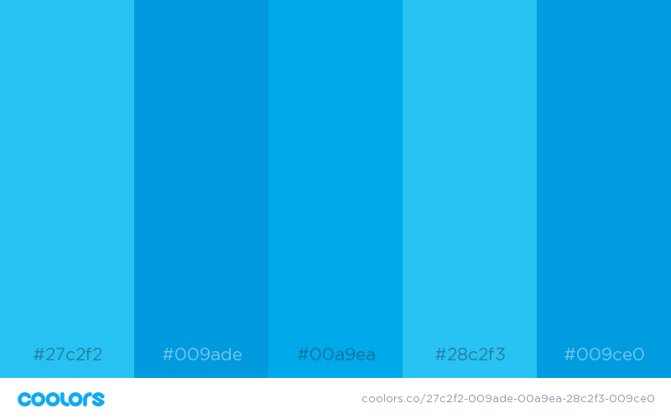
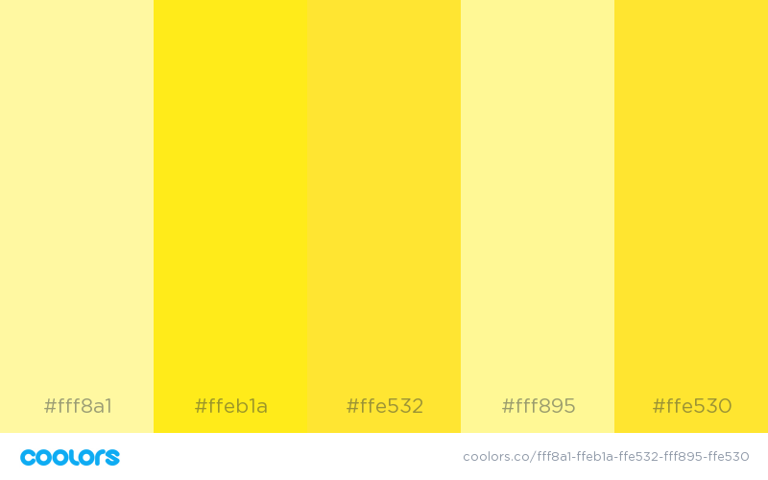
Style Guide
Bradley Hand (title)
Arial (Text, navigation drawer, etc.)
Arial will be used as the default text on on portions of the app, with the exception of text that might accompany the forecast that is passed in by a webview.

Slide 13
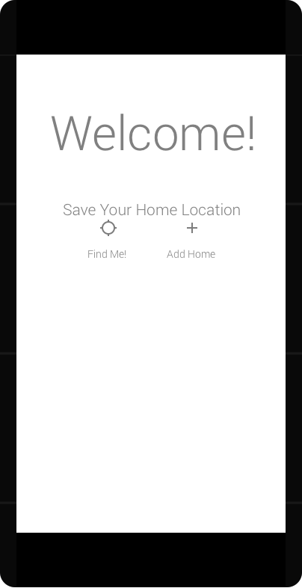
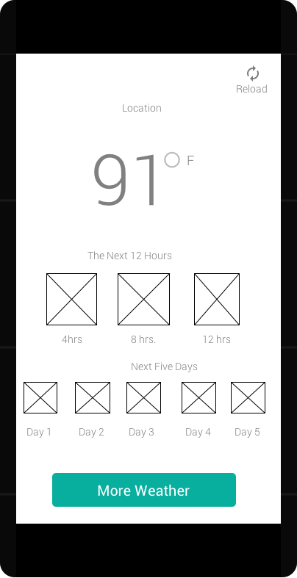
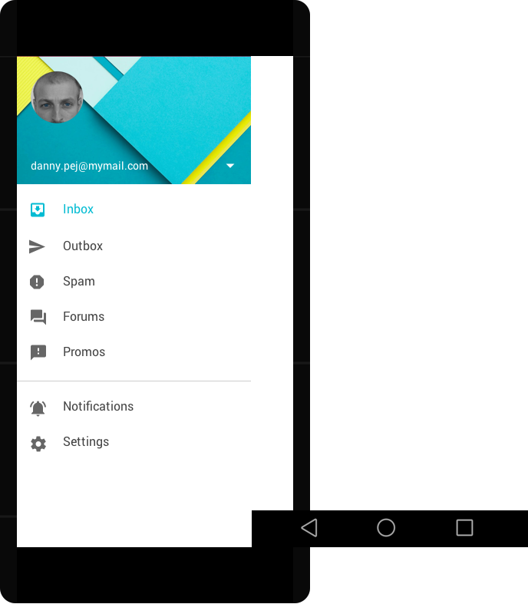
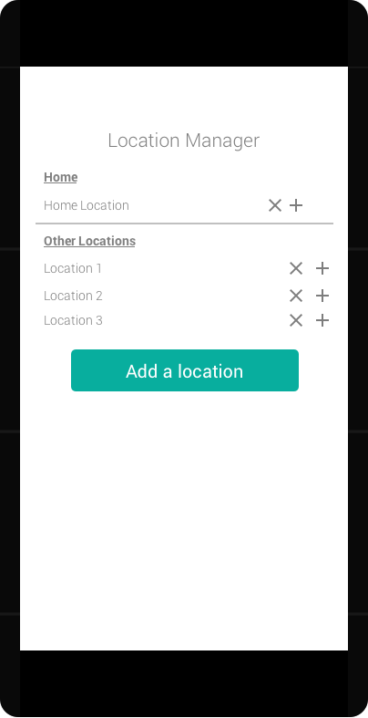
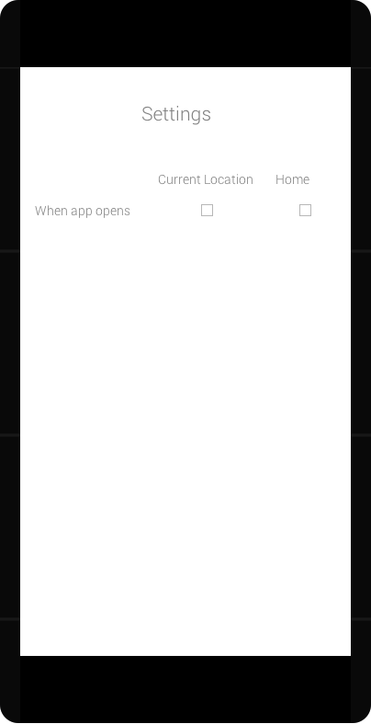
Wireframes

Slide 14
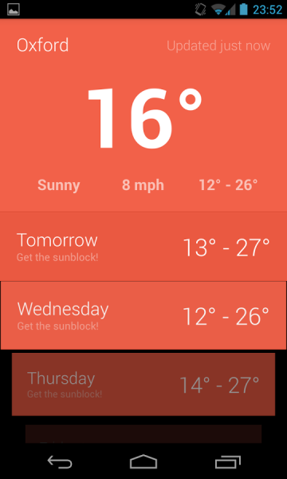
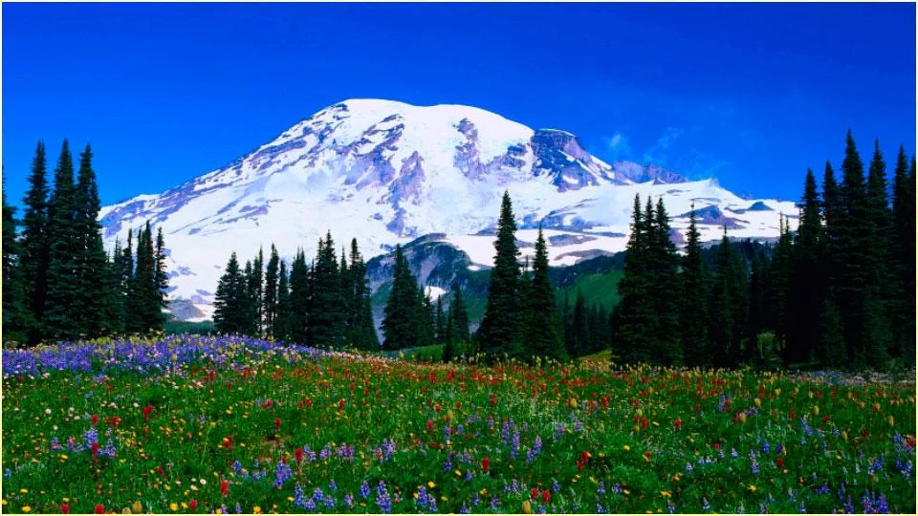

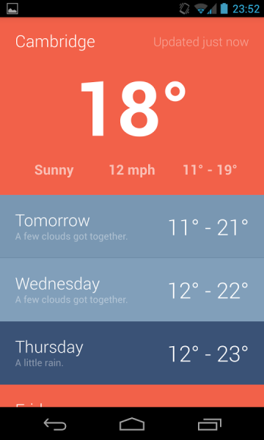
Mood Boards

Slide 15
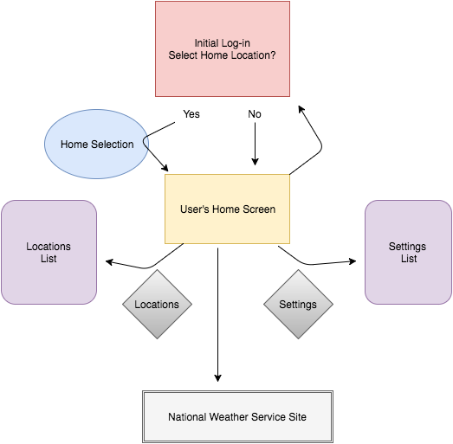
Application Flow

Slide 16
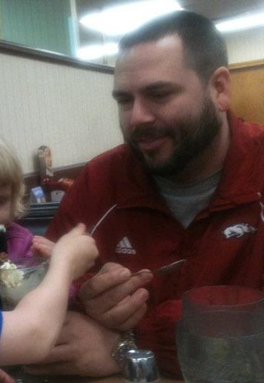
About the Developer
Chris Carlisle
Android Developer
Father
Overall Cool Dude

